Slide 1

Insulin Optimization App
Team Members: Mojahed Taleb - Omar Sawwas (Team Leader) - Abed Al Rahman Sakr - Mohammad Karim Abo Hosa

Slide 2
Project significance:
Problem statement:
The project will help diabetic patients optimize their insulin intake using previous data from the user and other users.
The problem is that it is hard to evaluate how much insulin should be injected for a specific food that the patient has never tried before. Also, it is hard to calculate and keep track of the insulin increase or decrease for specific foods based on glucose levels.

Slide 3

Project Scope:
The plan is to build a free app that will:
Give the users access to a data base of how much insulin they should take on specific food
The database will update and be more optimized every time the user enters new data.
Give better and more organized data to the patient’s doctor
We may face limitations at the beginning of the project due to it depending on previous data.

Slide 4
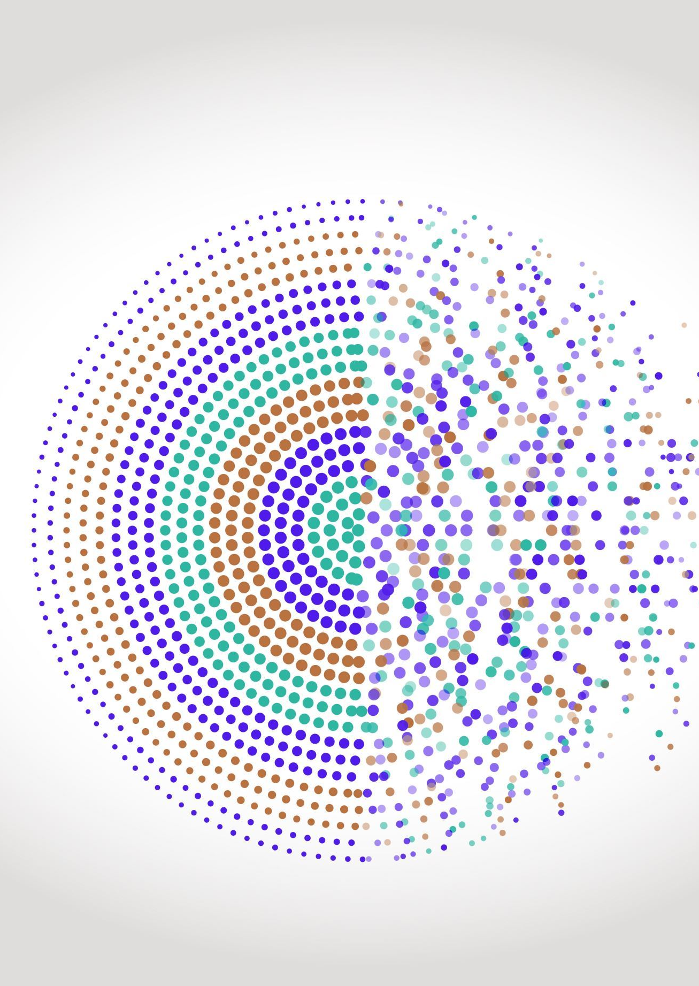
SDLC Model:
We will be using the incremental model because our project will be divided into 2 functioning increments:
The first increment just gathers data from diabetes users and analyses this data individually and optimizes the best insulin dose to be taken for the user.
Second increment that is a version two update will be after gathering some data, will be subjected to public diabetic patients where it will work on analyzing data based on machine learning algorithms to give recommendations for other patients for the best insultation for insulin dosage.
Each increment by itself will depend on the waterfall model that ensures the full functionality of it from the phase of analysis till the testing phase and this is our case.
Our project should ensure fast release to help diabetes patients take benefit from our service.

Slide 5
Feasibility Study:
Year | Year 0 |  | Year 1 |  | Year 2 |  | Year 3 |  | Year 4 |  | Year 5
Division | half 1 | half 2 | half 1 | half 2 | half 1 | half 2 | half 1 | half 2 | half 1 | half 2 | half 1 | half 2
Costs
Development | $3,500.00 | $2,500.00 | $1,000.00 | $500.00 | $6,000.00 | $4,000.00 | $1,200.00 | $1,200.00 | $1,200.00 | $1,200.00 | $1,200.00 | $1,200.00
Transportation Fee | $800.00 | $800.00 | $0.00 | $0.00 | $1,000.00 | $1,500.00 | $0.00 | $0.00 | $0.00 | $0.00 | $0.00 | $0.00
Laptops & Mobile Cost | $4,500.00 | $1,500.00 | $0.00 | $0.00 | $0.00 | $0.00 | $0.00 | $0.00 | $0.00 | $0.00 | $0.00 | $0.00
Server rental | $0.00 | $0.00 | $60.00 | $60.00 | $100.00 | $100.00 | $150.00 | $150.00 | $200.00 | $200.00 | $200.00 | $200.00
Office rental | $2,400.00 | $2,400.00 | $1,200.00 | $0.00 | $1,000.00 | $500.00 | $0.00 | $0.00 | $0.00 | $0.00 | $0.00 | $0.00
Maintenance | $600.00 | $600.00 | $600.00 | $600.00 | $600.00 | $600.00 | $600.00 | $600.00 | $600.00 | $600.00 | $600.00 | $600.00
Totals
Number of User | $0.00 | $0.00 | $500.00 | $1,500.00 | $3,000.00 | $5,000.00 | $7,000.00 | $9,000.00 | $11,000.00 | $13,000.00 | $15,000.00 | $17,000.00
Total Cost | $11,800.00 | $7,800.00 | $2,860.00 | $1,160.00 | $8,700.00 | $6,700.00 | $1,950.00 | $1,950.00 | $2,000.00 | $2,000.00 | $2,000.00 | $2,000.00
Revenue | $0.00 | $0.00 | $1,825.00 | $5,475.00 | $10,950.00 | $18,250.00 | $25,550.00 | $32,850.00 | $40,150.00 | $47,450.00 | $54,750.00 | $62,050.00
Cash Flow | -$11,800.00 | -$7,800.00 | -$1,035.00 | $4,315.00 | $2,250.00 | $11,550.00 | $23,600.00 | $30,900.00 | $38,150.00 | $45,450.00 | $52,750.00 | $60,050.00
Cumulative Cash Flow | -$11,800.00 | -$19,600.00 | -$20,635.00 | -$16,320.00 | -$14,070.00 | -$2,520.00 | $21,080.00 | $51,980.00 | $90,130.00 | $135,580.00 | $188,330.00 | $248,380.00

Slide 6
Feasibility Study:

Slide 7
Non-functional requirements
Sign contracts with restaurants and make partnerships to provide offers for patients.
Designing the app to be user-friendly (UX/UI).
The app should be launched fully functional within a year and released then.

Slide 8
Domain requirements
Fully functional version cross platforms (IOS /Android)
Getting supervised by doctors and dietitians to ensure the safe use of our application.
Get verification from health authorities to make sure the app is safe to use for patients.

Slide 9
Functional requirements
Adding new meals eaten.
Seeing recommendations.
Doctor supervisions.
Restaurants meals.
Recommendation improvements.

Slide 10
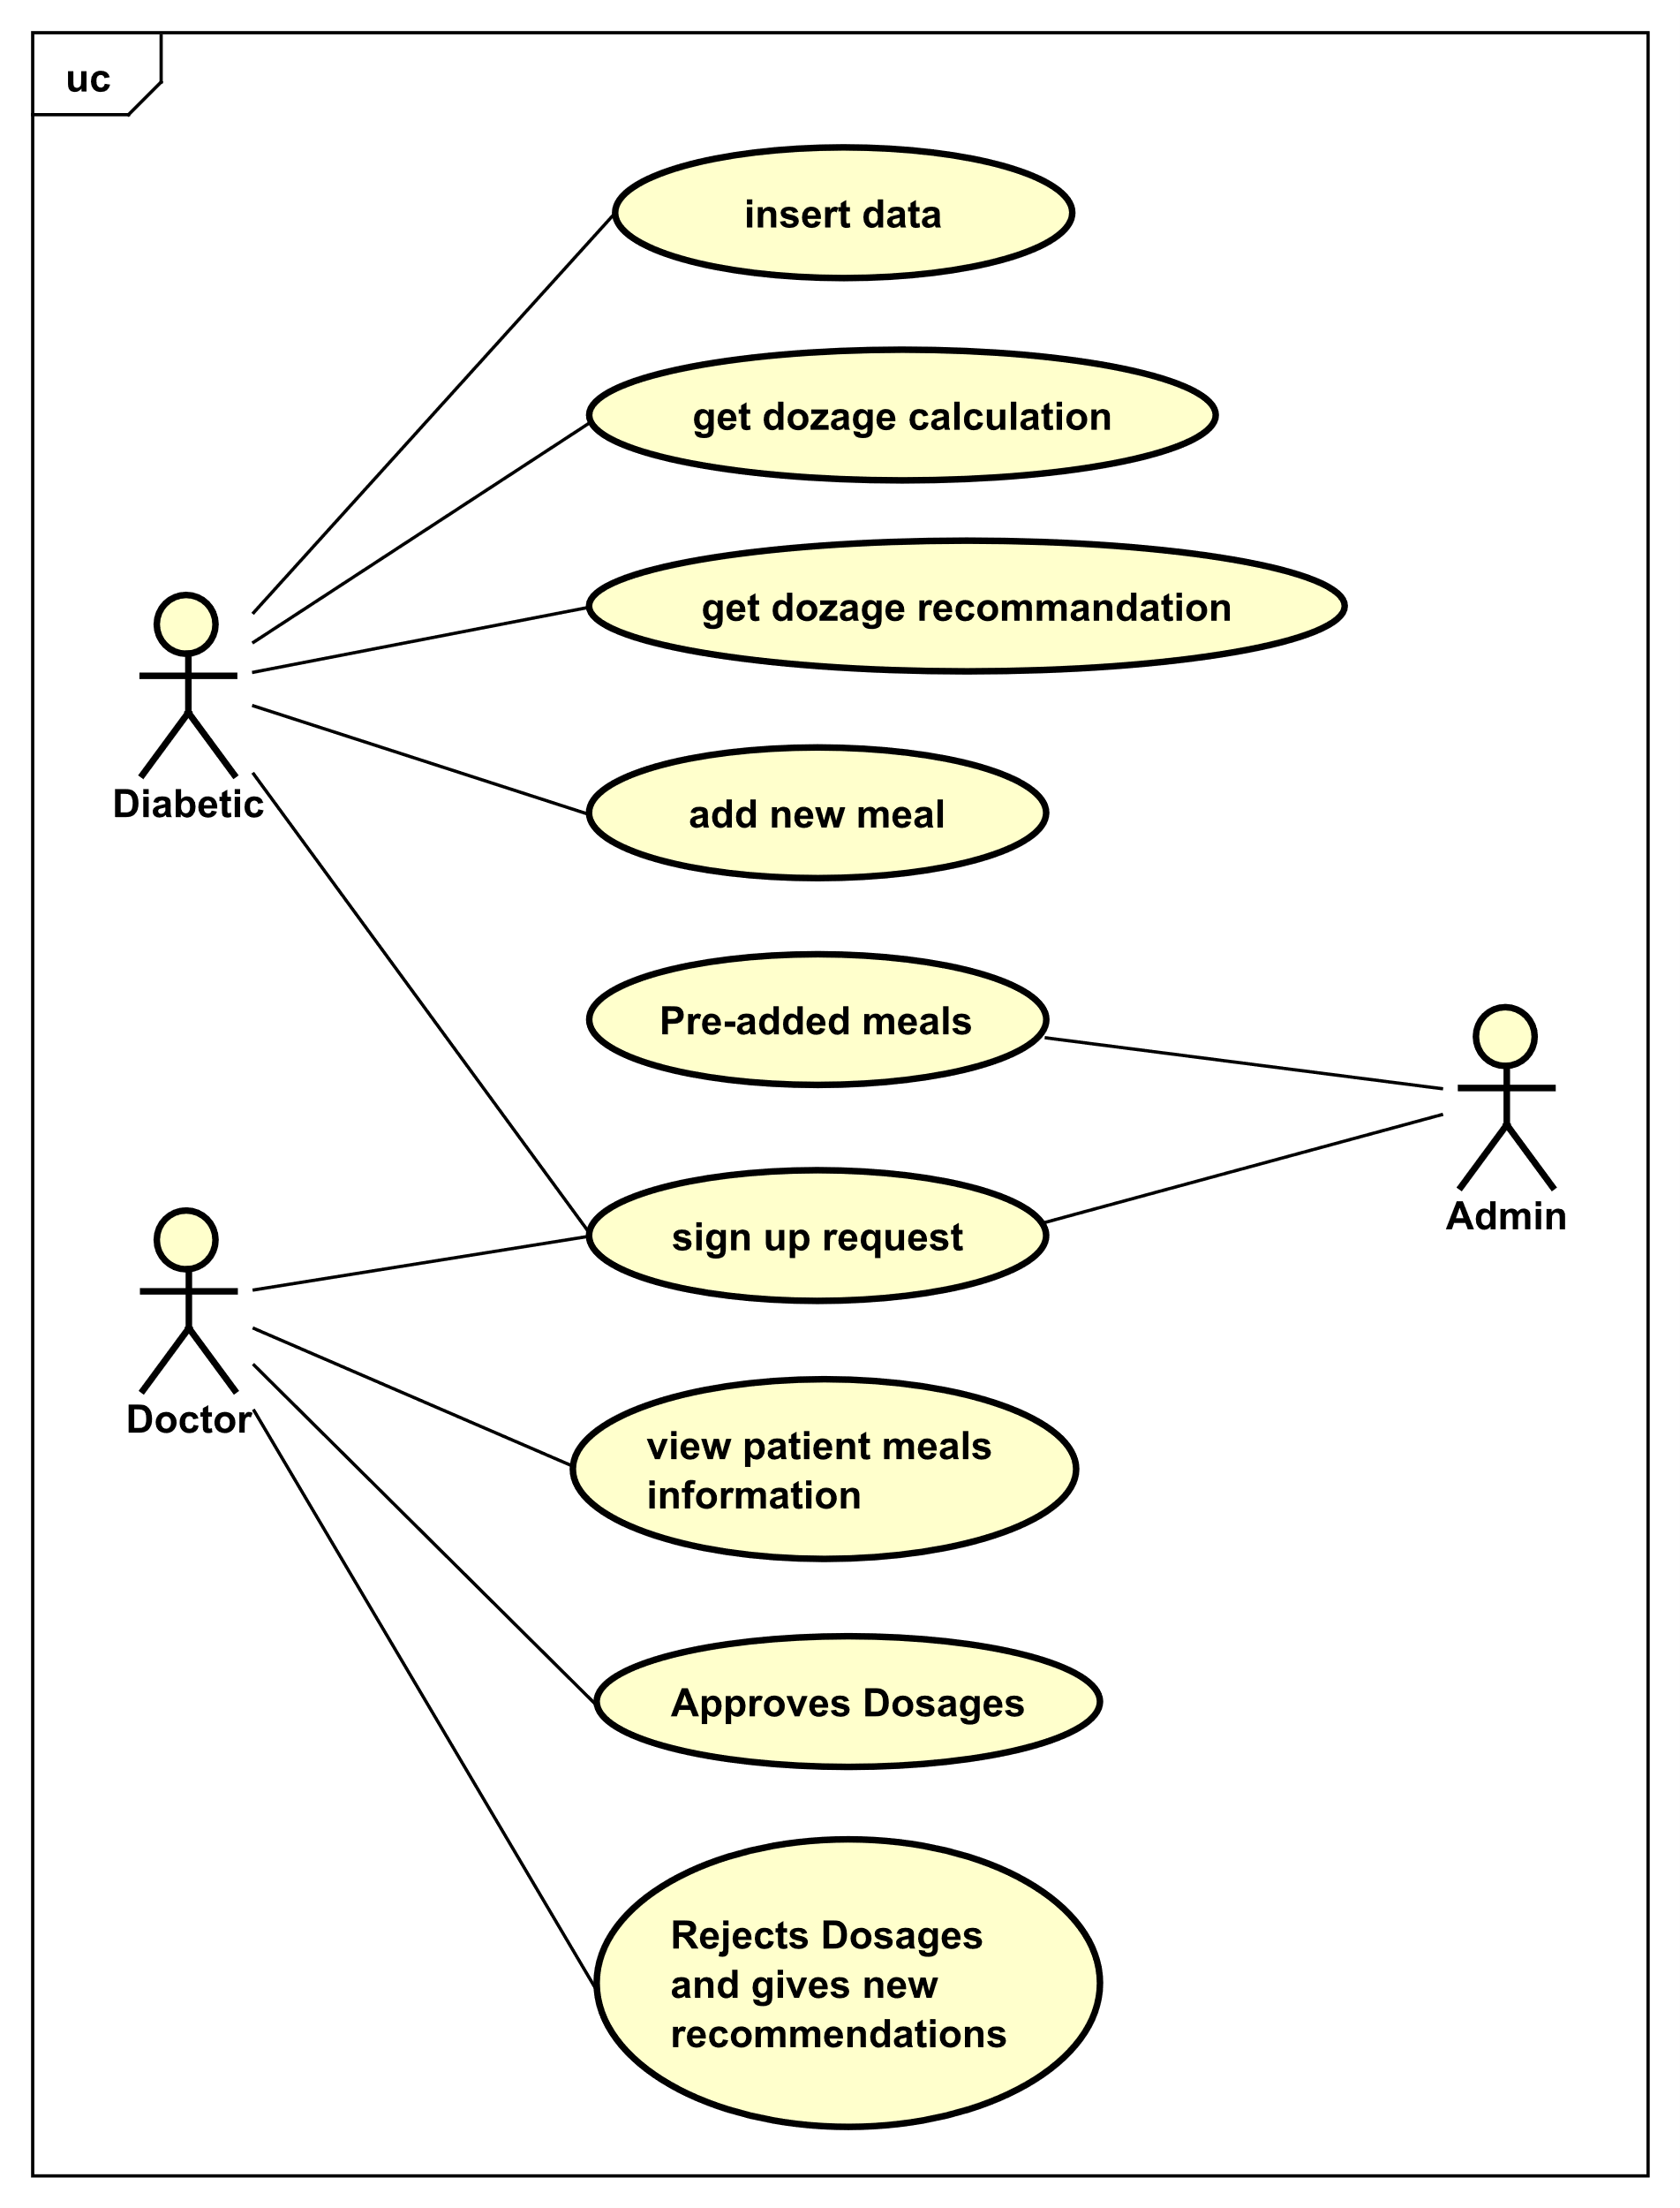
use Cases Diagram:

Slide 11
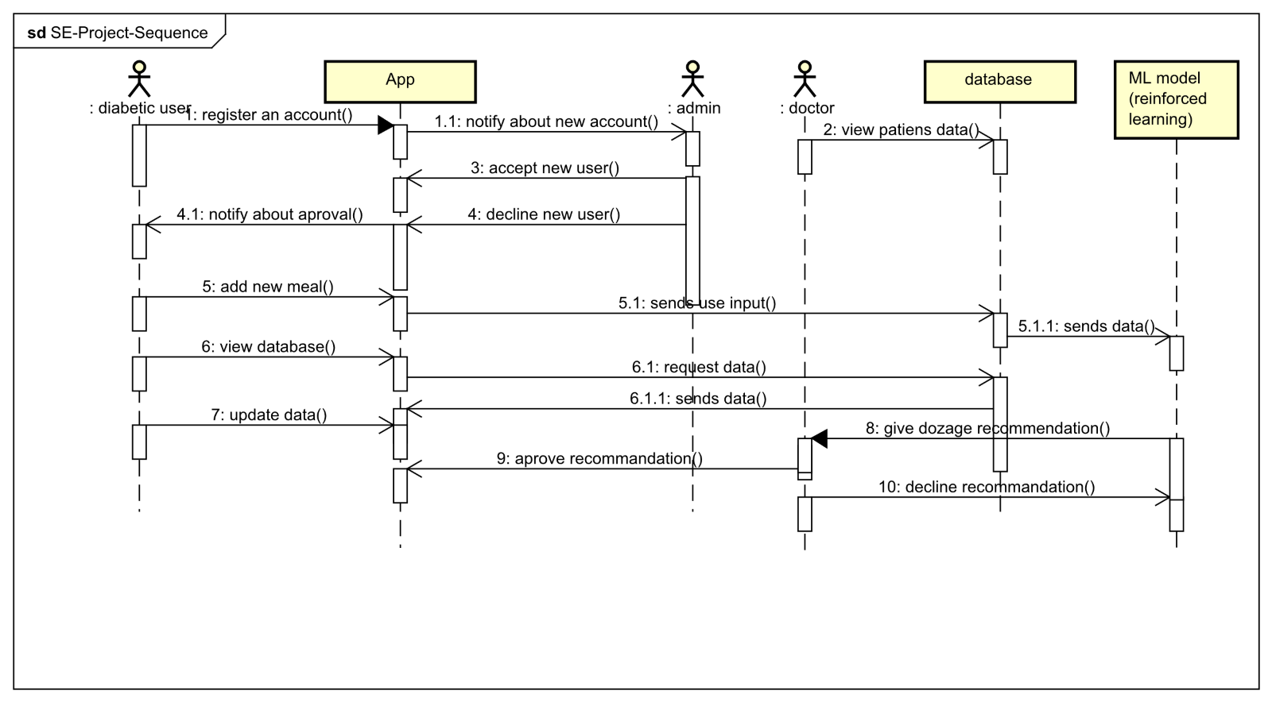
SEQUENCE DIAGRAM:

Slide 12
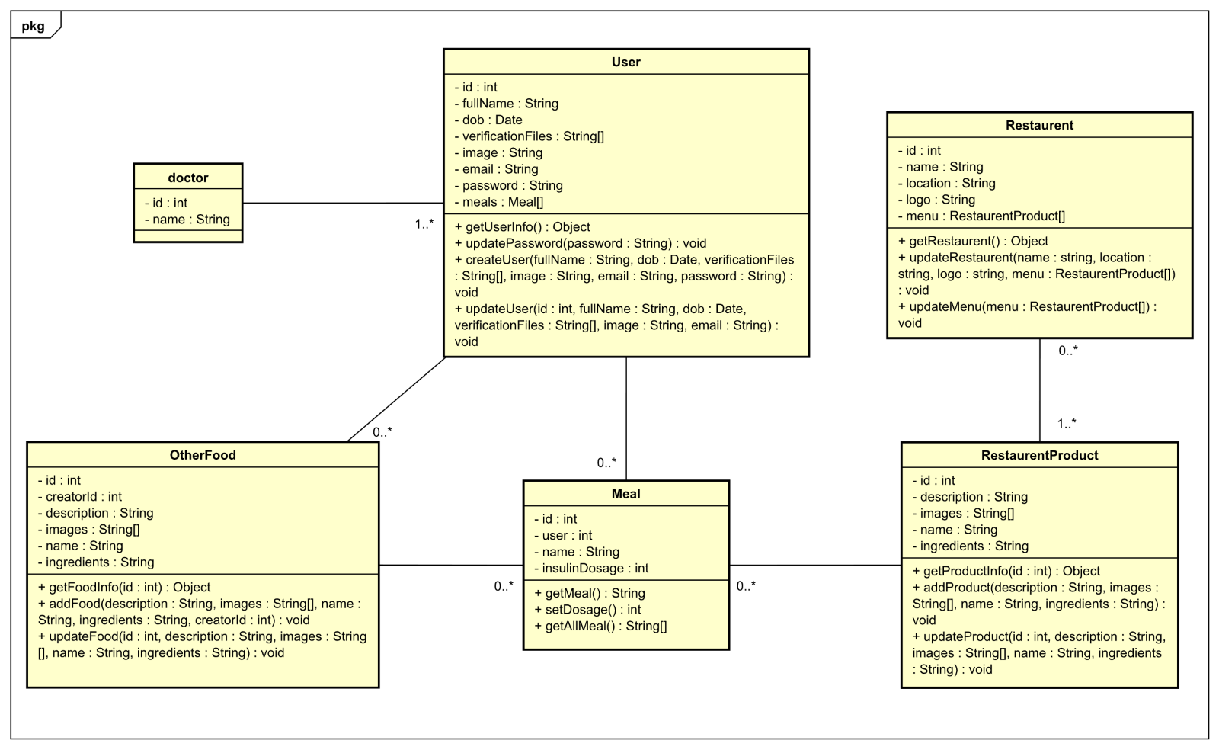
Domain/class object diagram

Slide 13
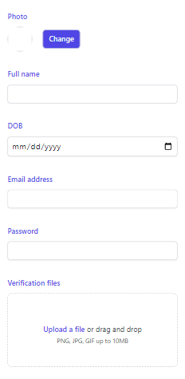
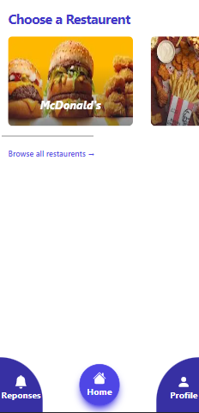
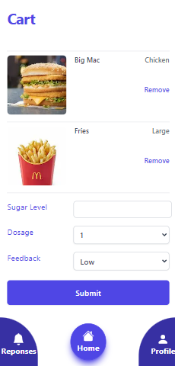
User Interface (UI):
Sign up Page
Home Page
Add Meal

Slide 14
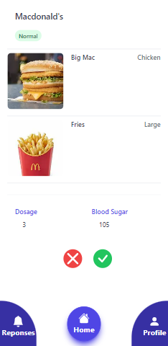
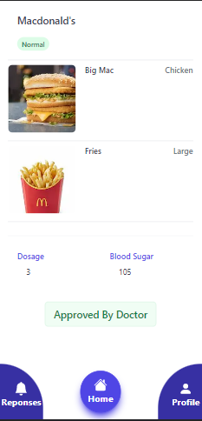
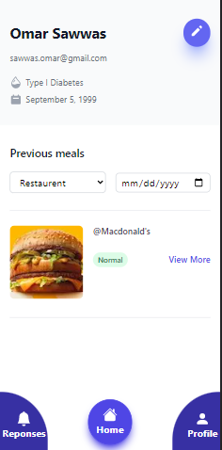
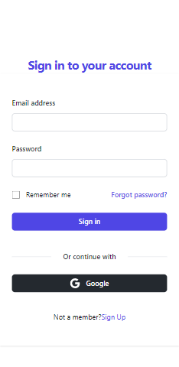
User Interface (UI):
Doctor Approval
Approved Page
Profile Page
Sign in Page

Slide 15
IMPLEMENTATION
Frontend: React Native – React Redux - Typescript
Backend: Express JS(Node) - Graph QL - Typescript

Slide 16
Testing
We will use typescript
Debugging tools like logging information on the counsel.
Beta version to general users.

